Slide 1

Bronco Baseball Pitching Mechanics

Slide 2
Why do we care about mechanics?
Repeatability
Command
Arm health
Maximum Velocity
Deception from pitch to pitch (off speed comes out of hand like Fastball)

Slide 3
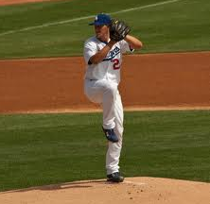
Balance
We want to be balanced all the way through our delivery not just at the balance point like Clayton Kershaw

Slide 4
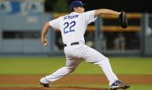
Balance

Slide 5

Balance

Slide 6
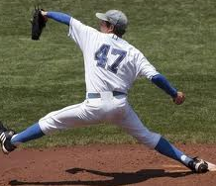
Balance

Slide 7
Leg Drive
Your legs are a huge element to your ability to throw hard and command the ball.
Foot speed and power output down the mound help determine where the ball is going and how hard it is going.
We want to actively push away from the rubber without jumping toward the plate.

Slide 8
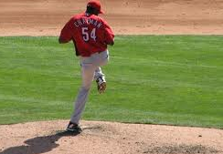
Load up for leg drive

Slide 9
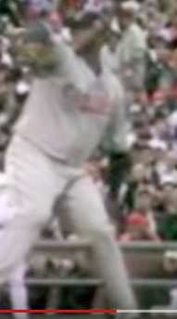
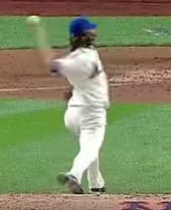
Leg Drive

Slide 10
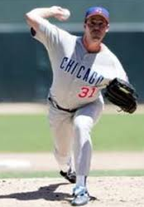
Line
Maintaining a straight line toward your target will allow you to have great command and will help you get to full extension thus maximizing power.

Slide 11
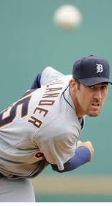
Line

Slide 12

Line

Slide 13
Timing
Timing, rhythm, and tempo in your delivery allows your body to repeat your mechanics over and over again.
The more quickly you get down the mound the faster you throw.
Timing is everything from how quickly you go through your delivery, to your rocker step, to where your hands break.
We must have a quick tempo every time we play– put the pressure on the hitter.

Slide 14
Hand Break, foot speed and front side!
The most important thing we can do in order to repeat our mechanics and deliver the ball on time is break our hands before we drive away from the rubber.
Most guys tend to break their hands too late and lots of issues with command pop up.
For most of us (not all) our hands have to break before we move forward down the mound. This is the key to our timing.
We want to move our feet as fast as we can down the mound maintaining control of our body.
Elite guys clear their front side early, and tuck it back in to maintain line and energy to the plate.

Slide 15
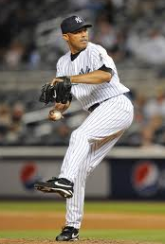
Timing

Slide 16
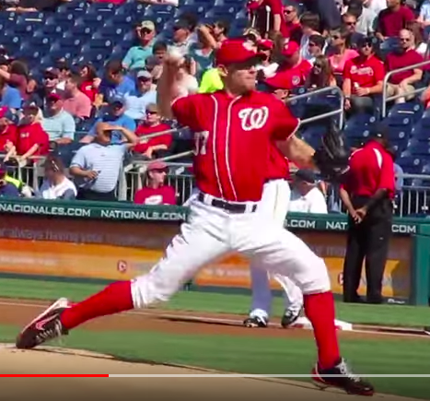
Timing/ Front side clear

Slide 17
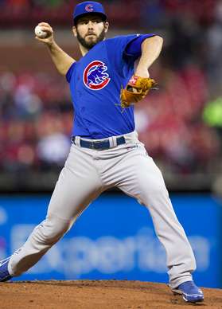
Clear your front

Slide 18
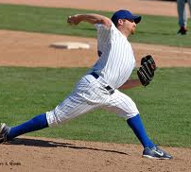

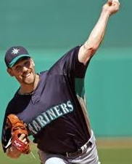

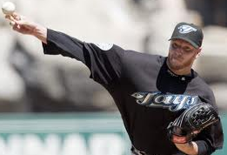
Front Side
Your front side needs to pull hard and then find it’s way back tight to the body.

Slide 19
Head position/ Strong Chest/ Inverted C
For most guys where their head goes is going to be where the ball goes.
We need to push a strong chest to the plate and take all our energy in one direct line.
Let’s use the boxing analogy…

Slide 20
Head Position/ Strong Chest/ Inverted C

Slide 21
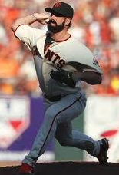
Strong Chest

Slide 22

Strong Chest

Slide 23
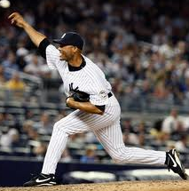
Extension

Slide 24
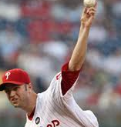
Extension

Slide 25
Finish

Slide 26
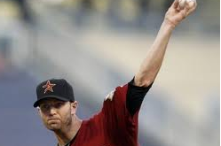
Finish

Slide 27
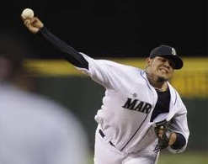
Finish

Slide 28
Hand and Wrist Position
When people talk about being on top of the ball they mean getting your hand on top. Naturally we want to be on top.
We need to know how we are manipulating our hand to generate spin.
Wrist angle will determine the movement on the ball.
Forearm strength will allow us to spin the ball harder on all of our pitches.
Hand and wrist position = ability to finish pitches.

Slide 29
Finish/Hand/ Wrist

Slide 30
Finish/ Hand/ Wrist

Slide 31
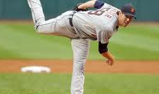
Follow through

Slide 32
Follow Through

Slide 33
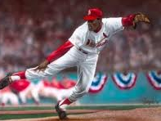
Follow Through

Slide 34
Lines and Circles
When we pitch our bodies operate in straight lines to the plate. The more on line we can be the better we will be.
While we try to maintain great lines, we also spin and turn on a variety of axis– hips, shoulders, elbows.
To protect our arms we must let it complete it’s circle rather than being overly linear on our follow- through.

Slide 35



Dump Truck, Merry-go-round, Ferris Wheel
Think of your body in three parts– your legs are the dump truck, your abs are the merry-go-round and your arm is the ferris wheel.

Slide 36

Stride length
The normal stride length for 90% of guys is between 5-6 of your own feet stepped out heal to toe from the rubber. We want your stride to be as long as comfortable– it is an indicator of velocity!

Slide 37
We are all different
There are very few things in pitching mechanics that are perfect and that have to be done.
Everyone pitches differently– the key is mastering your own mechanics.
Repeatability is the key to success!

